Slide 1
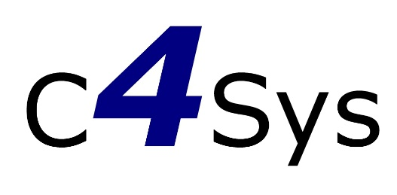
Bioinformatics for Microbiology: Toolbox or Pandora box?
Center for Systems Biology
Institute of Microbiology
Czech Academy of Sciences
Daniel Kumazawa Morais
Laboratory of Environmental Microbiology
Institute of Microbiology of the CAS
16.10.2020
Czechoslovak Society for Microbiology
Notes:
Institute of Microbiology
In this effort to create a database
Abstract: "The relationship between humans and microbes attracts the scientific interest since the creation of the first lens by Anton van Leeuwenhoek. From the last 200 years, microbes have been strictly associated to diseases, a way of thinking that drove huge effort towards methods to avoid and eliminate them at all costs. This phobia and huge seek for a germ free environment ended up hindering our own health. Nowadays we are starting to realize their importance to our own physiology training our immune system, producing vitamins and processing the food we eat. Our thoughts about how to deal with microbes are changing in an unprecedented way. The knowledge regarding microbial communities and their behaviour is increasing daily thanks to our new capacity of generating genomic data. Using high-throughput sequencing platforms we are now uncovering a huge diversity of still unknown metabolisms and microbial species. All this information is being stored in public database and the methods for processing and interpreting this information became our biggest bottleneck. Every microbiologist nowadays feels the need to learn how to manage biological data in a more effective way. In this speech you will learn the most used strategies for microbial community data analyses and how a bioinformatician could contribute to be part of this massive paradigm change that microbiology is undergoing."

Slide 2
Google’s tribute to the birthday of Antoni van Leeuwenhoek. 24.10.1632
Notes:
http://google.com/doodles/antoni-van-leeuwenhoeks-384th-birthday
Google’s tribute to the birthday of Antoni van Leeuwenhoek
The father of microbiology

Slide 3
Mothur – Cited 13,900 times
Schloss, Patrick D., et al. "Introducing mothur: open-source…" Appl. Environ. Microbiol. 75.23 (2009): 7537-7541.
Notes:
Mothur – Cited 11,600 times

Slide 4
Mothur – Cited 13,900 times
Schloss, Patrick D., et al. "Introducing mothur: open-source…" Appl. Environ. Microbiol. 75.23 (2009): 7537-7541.
Notes:
Mothur – Cited 11,600 times

Slide 5
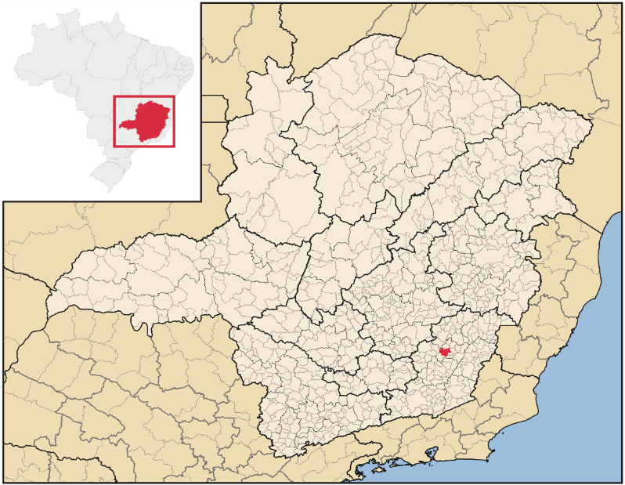
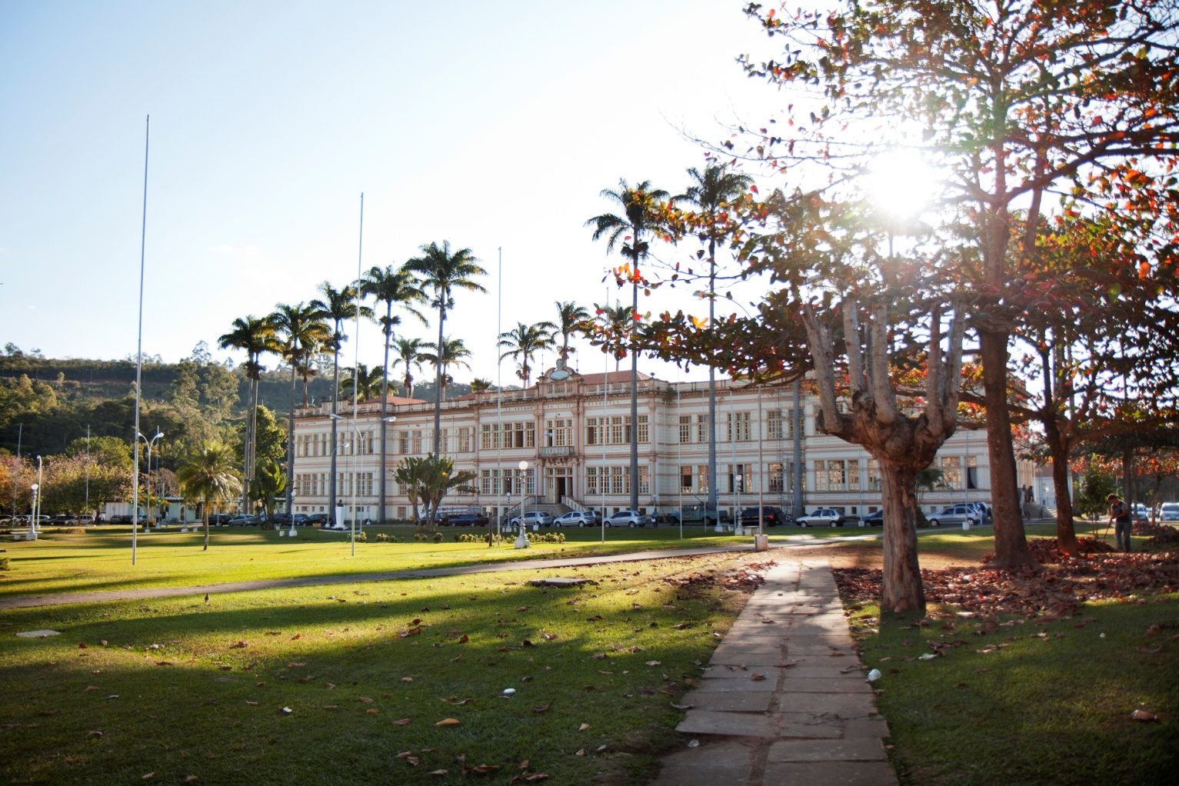
Masters and PhD in Agricultural Microbiology.
Artur Bernardes Building
Federal University of Viçosa - Brazil
Notes:
Master and PhD in Agricultural Microbiology.

Slide 6
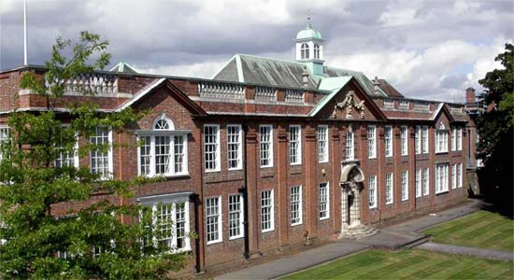
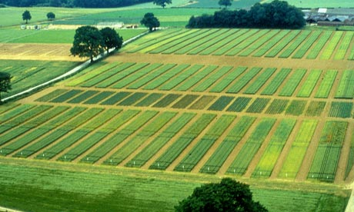
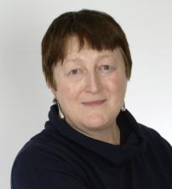
My first real contact with bioinformatics
Jenkinson Building - UK
Penny Hirsch
Microbial Ecology group
Department of AgroEcology
Rothamsted long term agicultural experiment – UK. (since 1842)
Notes:
Jenkinson Building

Slide 7
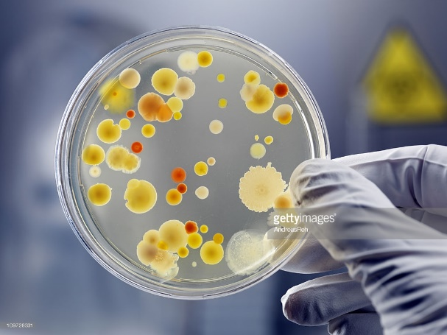
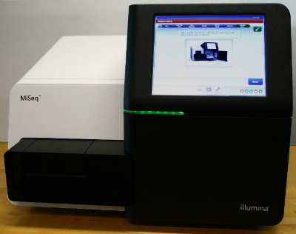
Microbial ecology
“The great plate count anomaly”
Classical microbiology methods
Gettyimages
The phenomenon of microbial uncultivability. Curr Opin Microbiol. 2013. Oct;16(5):636-42
Isolation of DNA
Sequencing
Notes:
Isolation of DNA

Slide 8
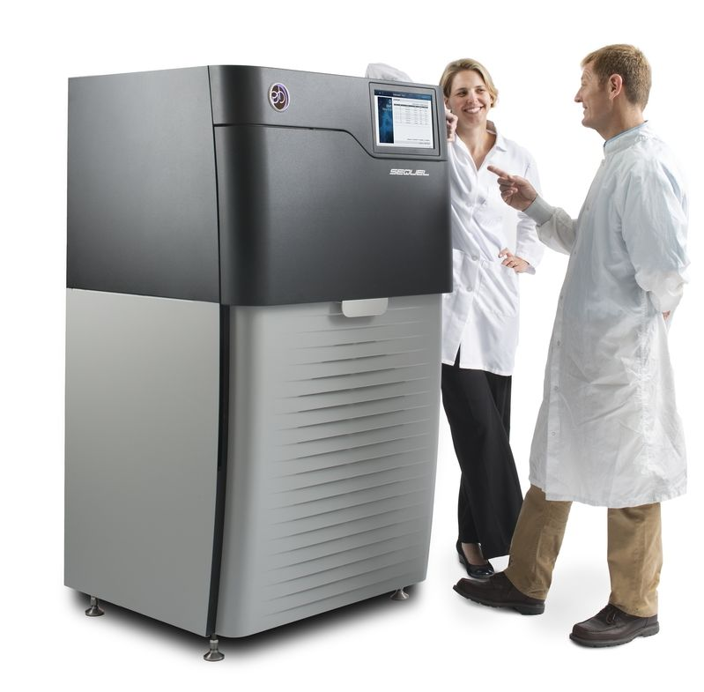
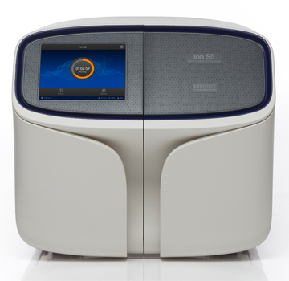
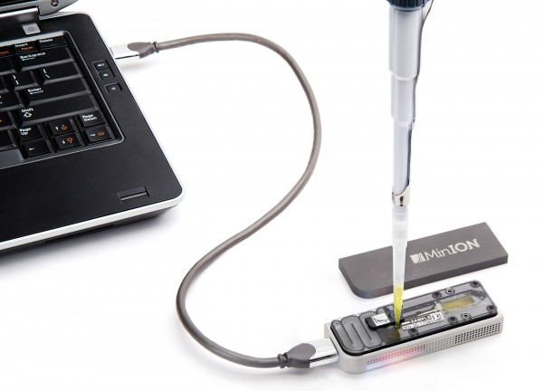
High-throughput sequencing
Illumina - MiSeq
Thermo Fischer - Ion S5
Pacific Biosciences - PacBio
Depending on the technology it is possible to get to 6 billion sequences and fragments of DNA ranging from 150 to 30 000 basepairs of length
Oxford nanopore - MinIon
Notes:
Depending on the technology it is possible to get to 6 billion sequences and fragments of DNA ranging from 150 to 30 000 basepairs

Slide 9
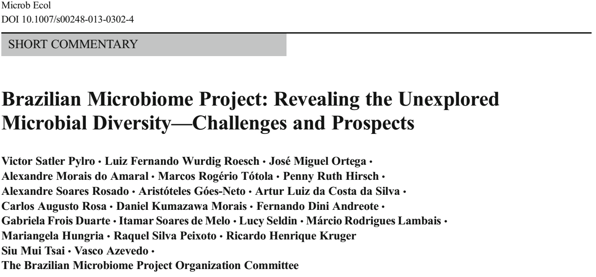
Microb Ecol. 2014 Feb;67(2):237-41
Notes:
Victor Pylro
Coordinator of the Brazilian Microbiome Project

Slide 10
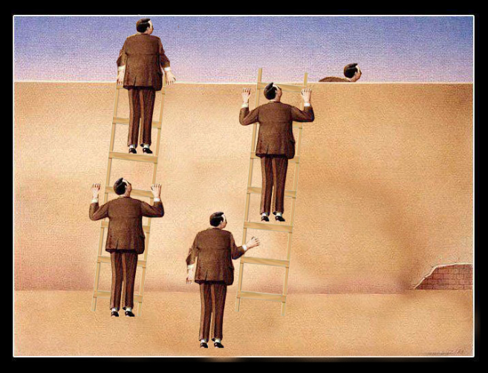

Slide 11
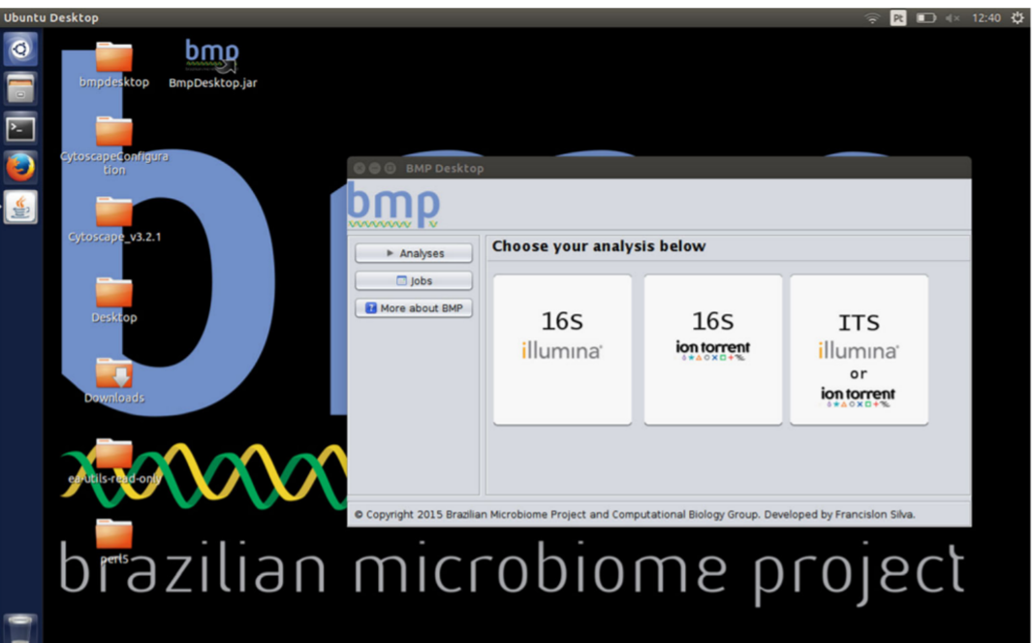
SEED 2 and BMPOS
Notes:
These tools help you to compare sequence data.

Slide 12
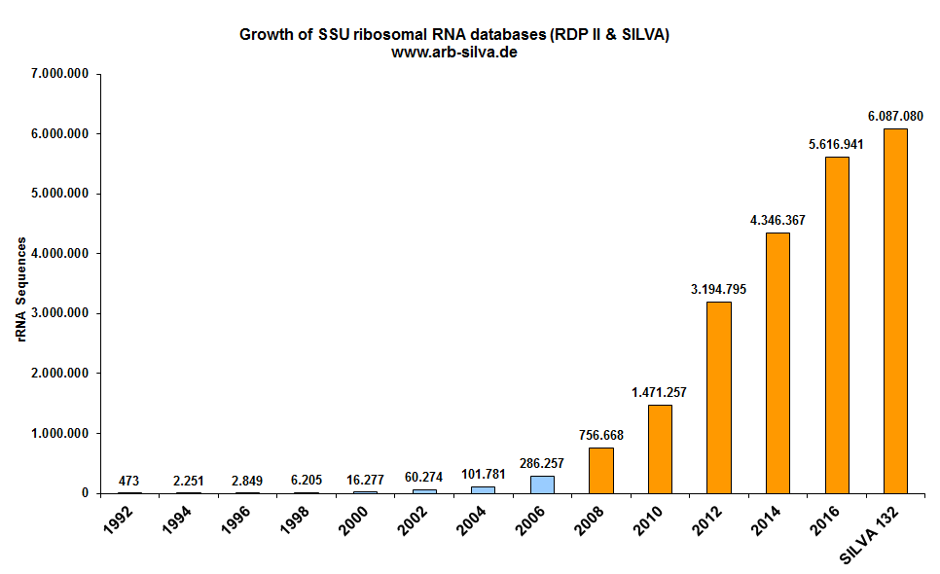
Sequencing and database expansion
First generation sequencing
(Sanger)
High-throughput short read sequencing
(454, Illumina, PGM)
High-throughput long read sequencing (Helicos, PacBio, Nanopore)
2018
RNA Sequences
6.087.080
Notes:
Sequencing and database expantion

Slide 13
High-throughput sequencing
Illumina - MiSeq
Thermo Fischer - Ion S5
Pacific Biosciences - PacBio
Depending on the technology it is possible to get to 6 billion sequences and fragments of DNA ranging from 150 to 30 000 basepairs of length
Oxford nanopore - MinIon
Notes:
Depending on the technology it is possible to get to 6 billion sequences and fragments of DNA ranging from 150 to 30 000 basepairs

Slide 14
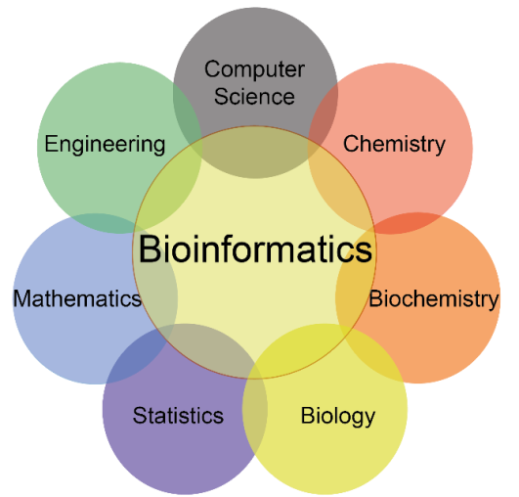

Slide 15
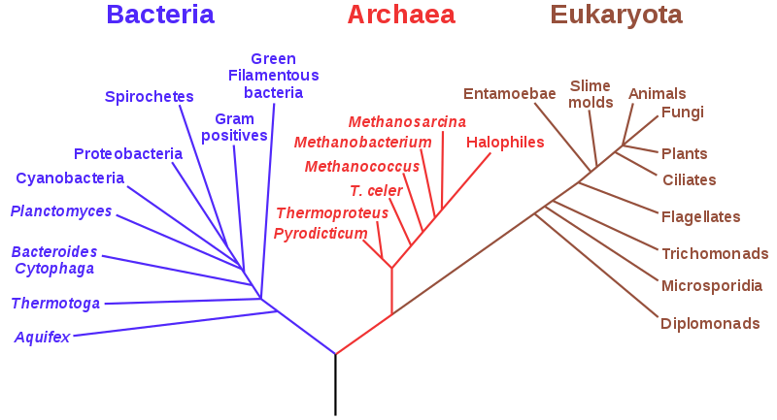
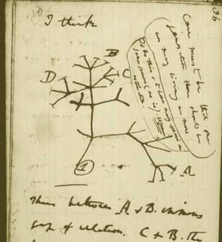
Why would we compare sequences?
Diversity of life is so great that to communicate about it we need an organization scheme.
Charles Darwin sketch of phylogenetic relationships
Carl Woese tree of life 1990
Notes:
Charles Darwin sketch of phylogenetic relationships

Slide 16
How to compare strings in information theory.
Hamming Distance
Levenshtein Distance

Slide 17
How to compare biological sequences?
Global alignment
Needleman–Wunsch
Local alignments
Smith-Waterman; BLAST
Alignment independent methods
K-mer frequencies
4 matches and 6 mismatches and 1 gap
Global alignment score(-3)
3 matches in a row in positions 4-7
Local alignment score (+3)
C | 1 | 1
E | 1 | 1
G | 1 | 1
K | 1 | 0
L | 0 | 1
P | 1 | 0
Q | 1 | 2
R | 0 | 1
S | 3 | 1
T | 0 | 2
Y | 1 | 0
Notes:
k=1 Seq1 [E = 1]
QKESGPYC
CEGKLPQRSTY

Slide 18
Microbiota analyses pipelines

Slide 19
Combination of both approaches to overcome DNA sequencing errors.
String comparison and biological sequence alignment.
Notes:
Combination of both approaches to overcome DNA sequencing errors.

Slide 20
In this article, the author used the 454 sequencer and found a species richness of 26 140 to 53 533 per gram of soil
Took more than a week to cluster the sequences in a big computer. 40 cores and 128 GB of Ram memory to analyse 500 000 sequences
Using DOTUR, a computer program for defining operational taxonomic units and estimating.
Schloss PD, Handelsman J. (2005). “Introducing DOTUR, a computer program for defining operational taxonomic units…”. Appl Environ Microbiol 71: 1501–1506.

Slide 21
Advances in Microbiology

Slide 22
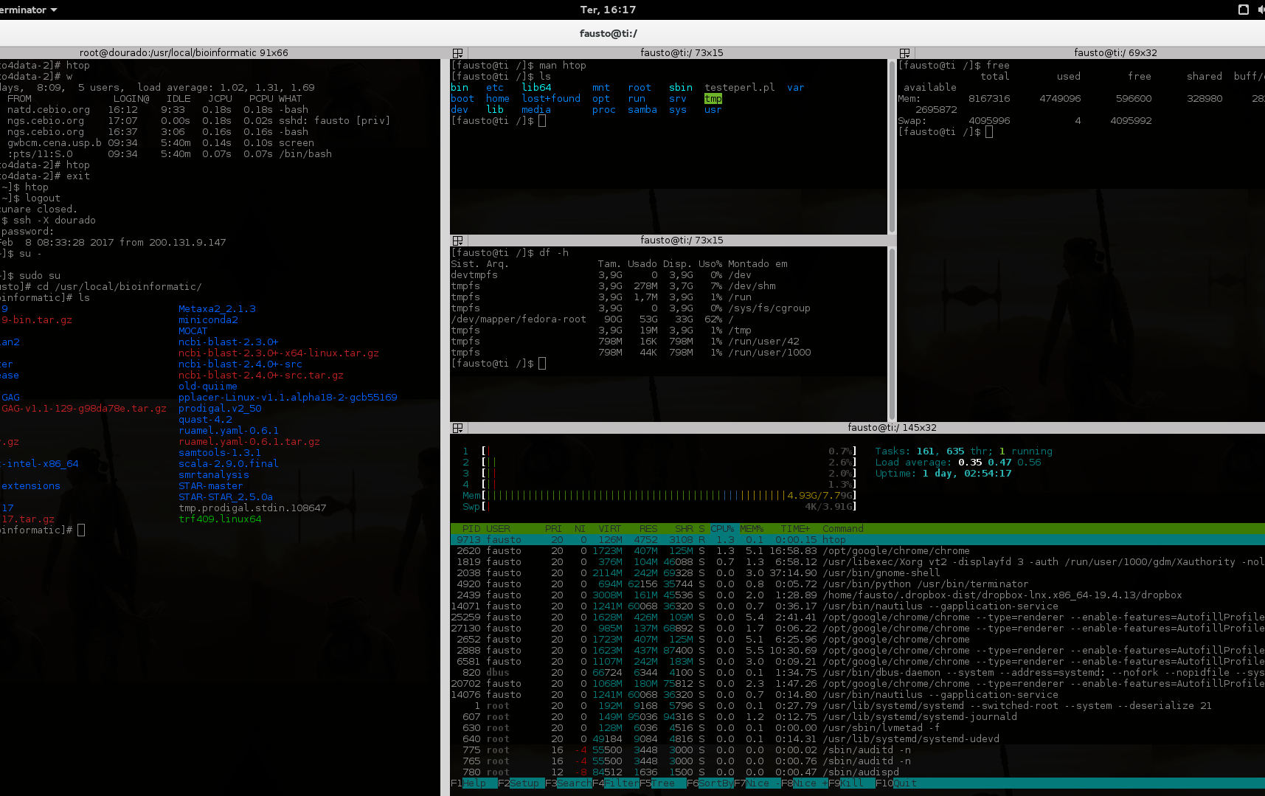
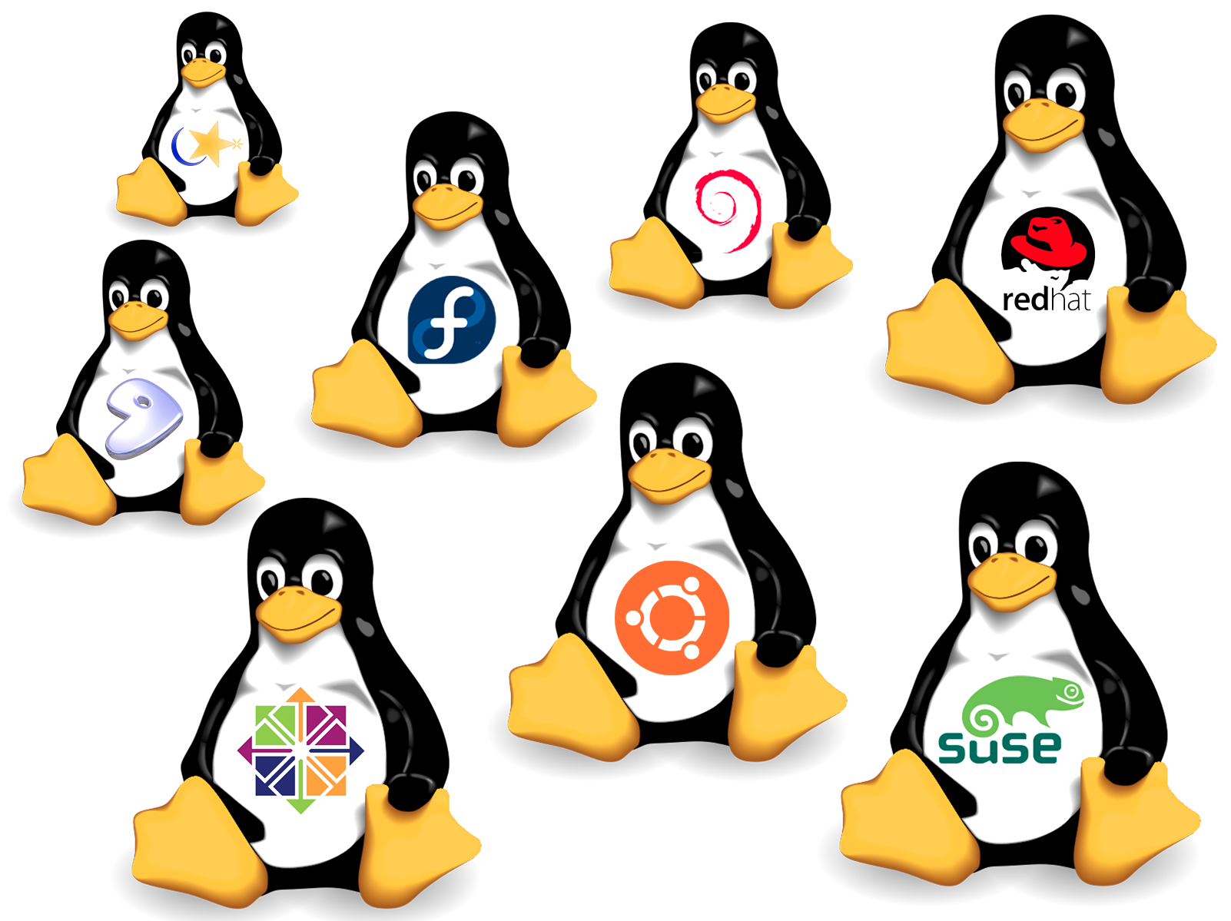
Linux Systems
Notes:
22

Slide 23
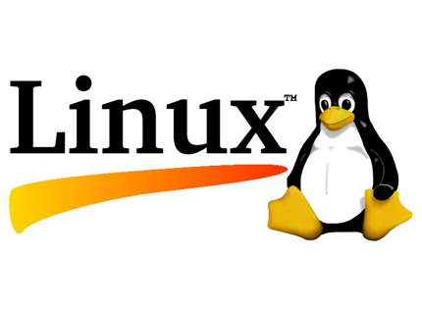
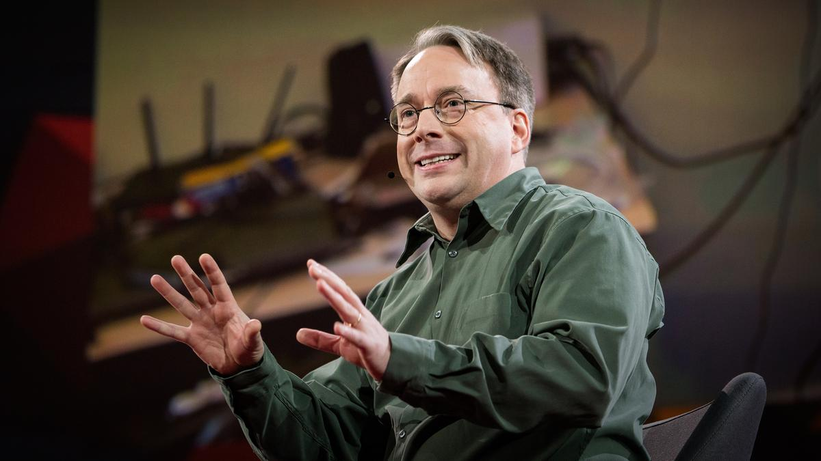
What is Linux?
Linux is a family of free and open sorce operating systems. It was released in 1991 and developed by Linus Torvalds.
This operating system is in your phones, smart TVs, home appliances, most of the internet servers, the top500 biggest supercomputers, stock exchange servers and of course desktop computers.
It got that big, thanks to voluntary colaborations around the world.
Linus Torvalds - https://www.ted.com/talks/linus_torvalds_the_mind_behind_linux
Notes:
http://www.cs.cmu.edu/~awb/linux.history.html
Carnegie Mellon University – School of Computer Science
https://www.ted.com/talks/linus_torvalds_the_mind_behind_linux
Linus Torvalds
23

Slide 24
If you want to learn more:
Bioinformatics and microbiome analysis - MB140P94
Lectures at Charles University (summer semester).
12 Lectures from February to June.
daniel.morais@biomed.cas.cz
Notes:
daniel.morais@biomed.cas.cz

