Slide 1
Iron nanomaterials in decontamination technologies and their interactions with microorganisms
RNDr. Jaroslav Semerád, Ph.D.

Slide 2
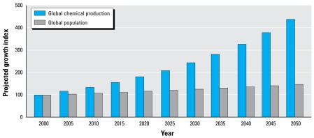
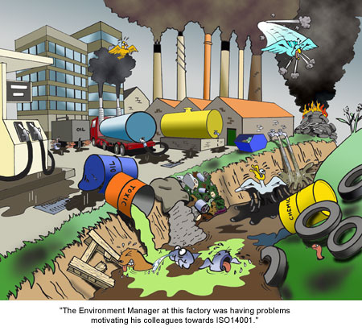
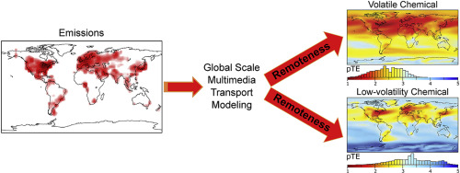
Worldwide contamination
Persistent organic pollutants (POPs) are organic compounds that are resistant to environmental degradation through chemical, biological, and photolytic processes.
Because of their persistence, POPs bioaccumulate with potential adverse impacts on human health and the environment.

Slide 3
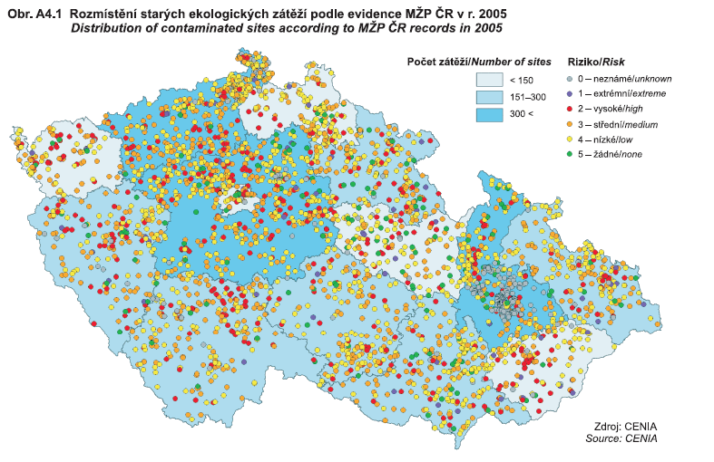
Decontamination technologies
Thermal desorption
Excavation or dredging
Surfactant enhanced aquifer remediation (SEAR)
Pump and treat
Solidification and stabilization
In situ oxidation
Soil vapor extraction
Nanoremediation
Bioremediation
Collapsing air microbubblesediation (SEAR)

Slide 4
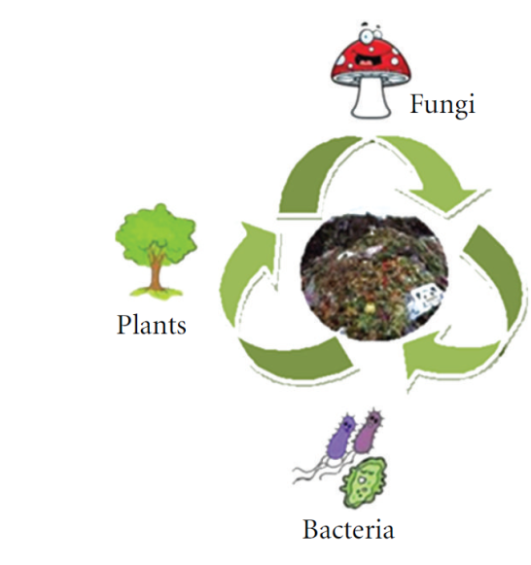
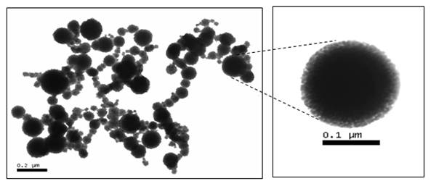
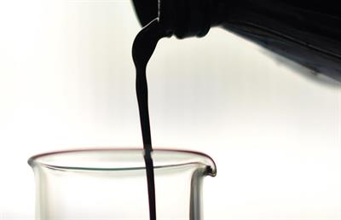
Decontamination technologies
Bioremediation
Nanoremediation
Nanobioremediation

Slide 5
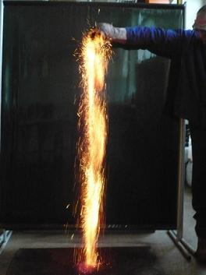
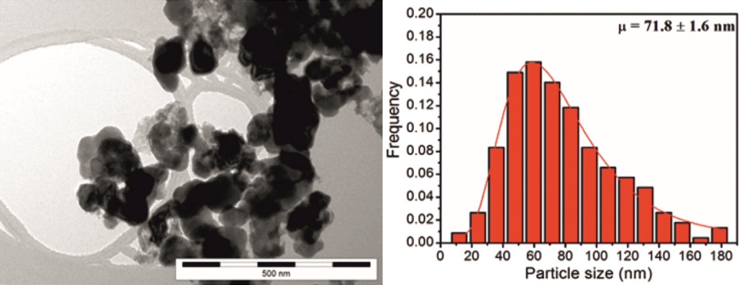
nanoscale Zero-Valent Iron (nZVI)
Fe⁰
Fe⁰ + oxidized X → Fe²⁺+ reduced X
Cr(VI) REDUCTION BY nZVI
Natural oxidation of Fe⁰ in water under aerobic and anaerobic condition:
2 Fe⁰ + 2 H₂O + O₂ → 2 Fe²⁺ + 4 OH⁻
Fe⁰ + 2 H₂O → Fe²⁺ + H₂ + 2 OH⁻

Slide 6
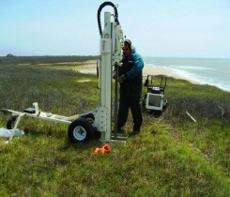
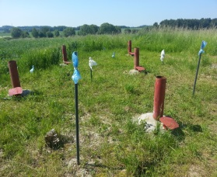






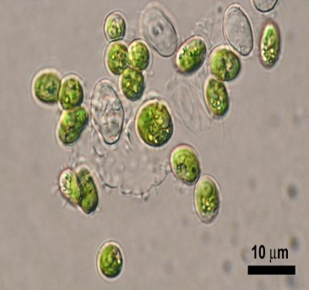

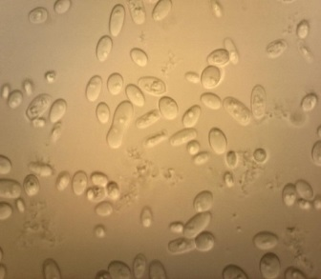
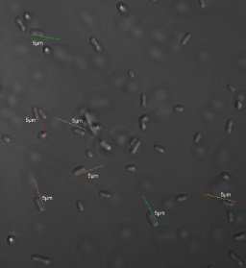
Time
Real concentrations used in practice (up to 10 g/L)
Complete oxidation
Fe⁰
Oxidation of nZVI - aging
Fe⁰
Waste water treatment
Interaction of nZVI with microorganisms
Soil and groundwater clean-up
Semerád, J, & Cajthaml, T 2016, 'Ecotoxicity and environmental safety related to nano-scale zerovalent iron remediation applications', Applied Microbiology And Biotechnology. ISSN: 1432-0614

Slide 7



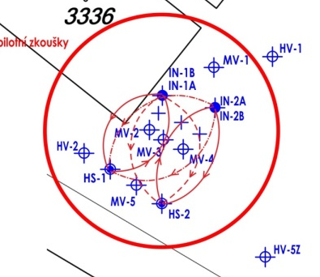
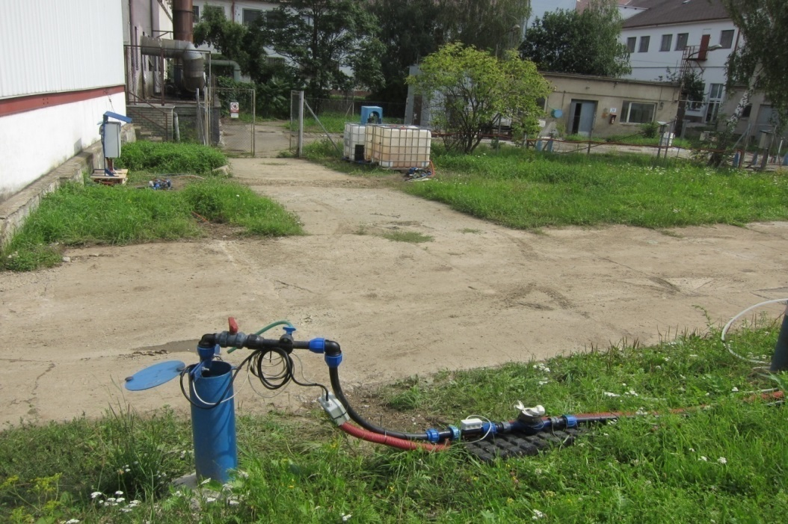
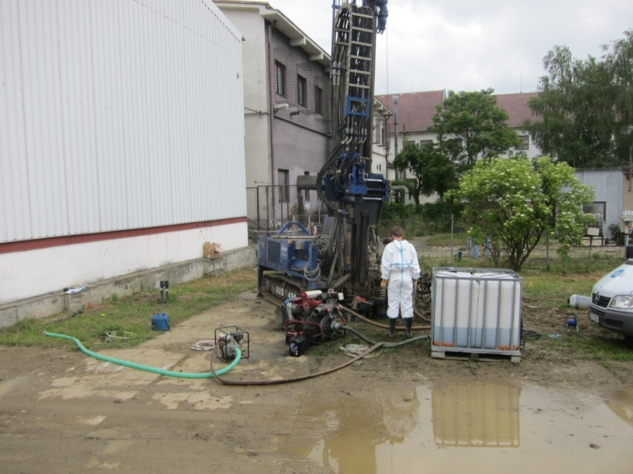
Combined Nano-Biotechnology for In-Situ Remediation of Mixed Contamination of Groundwater by Hexavalent Chromium and Chlorinated Solvents
Phase I: In-situ chemical reduction by nZVI (2 injection campaigns 20 kg nZVI each by direct push)
Phase II: Bioreduction stimulated by organic substrate (8 m³ of whey)
MV-1
IN-1
IN-2
MV-2
MV-3
MV-4
GW flow
HS-1

Slide 8
MICROBIOLOGICAL REDUCTION OF Cr(VI)
Aerobic reduction:
electron donor (reduced) + Cr(VI) (electron acceptor oxidized) + oxygen +bacteria = Cr(III)(electron acceptor reduced) + CO₂(electron donor oxidized) + H₂O
Anaerobic respiration:
electron donor (reduced) + Cr(VI) (electron acceptor oxidized) + bacteria = Cr(III)(electron acceptor reduced) + CO₂(electron donor oxidized) + CH₄
Electron donors: „natural“ organic substrates (humic and fulvic acids) or „artificial“ (e.g. ethanol, glucose, whey, glycerol, lactate, butyrate,...)
Indirect reduction:
Cr(VI) by Fe(II) or H₂S, originating by metabolism of iron reducing bacteria (IRB) and sulfate reducing bacteria (SRB)

Slide 9
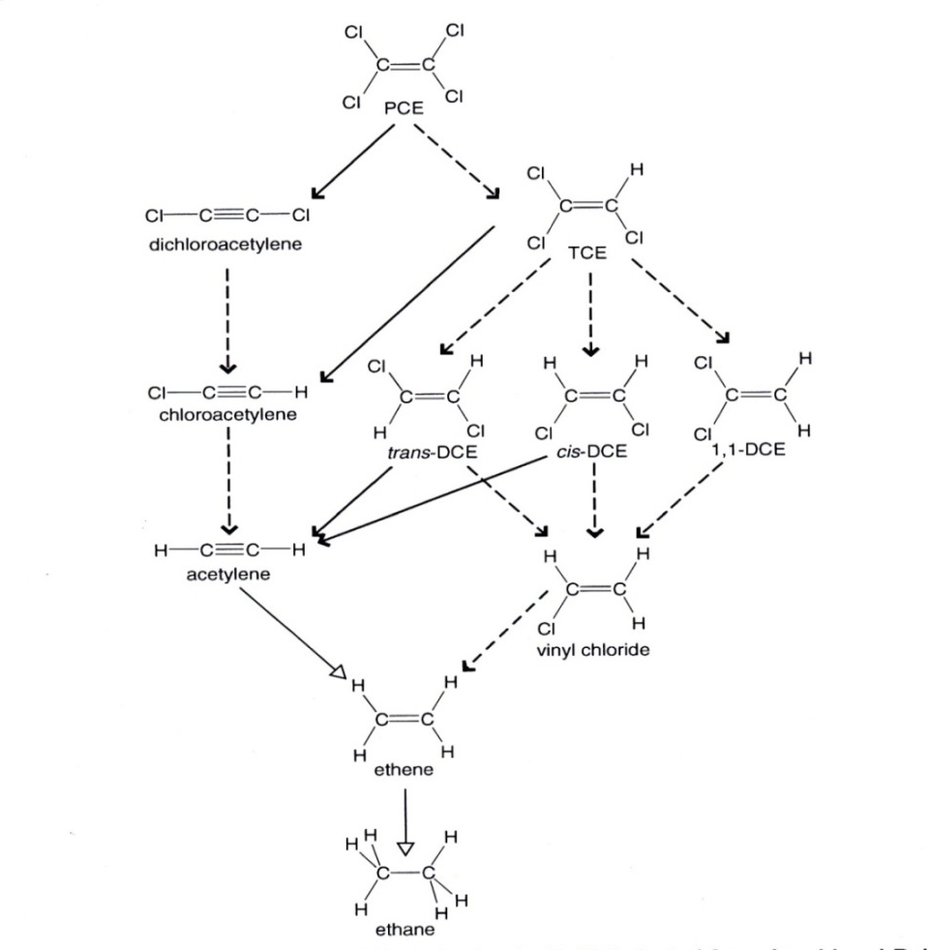
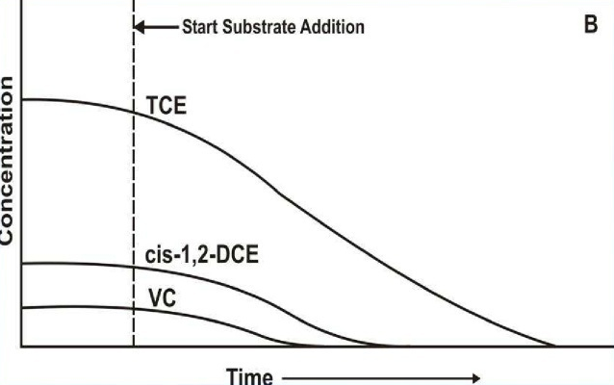
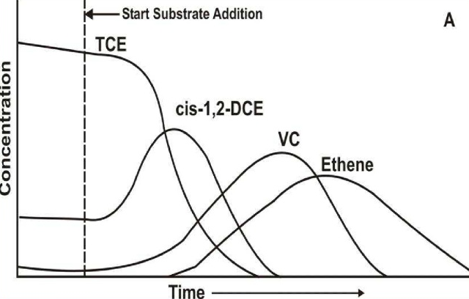
Combined Nano-Biotechnology for In-Situ Remediation of Mixed Contamination of Groundwater by Hexavalent Chromium and Chlorinated Solvents
Pathways of abio- and bio- reduction of chlorinated ethenes
CHCl=CCl₂ + 2e⁻→ HC≡CCl + 2Cl⁻
β-elimination
hydrogenolysis pathway
CH₂=CCl₂ + 2e⁻ + H⁺→ CH₂=CHCl + 2Cl⁻

Slide 10
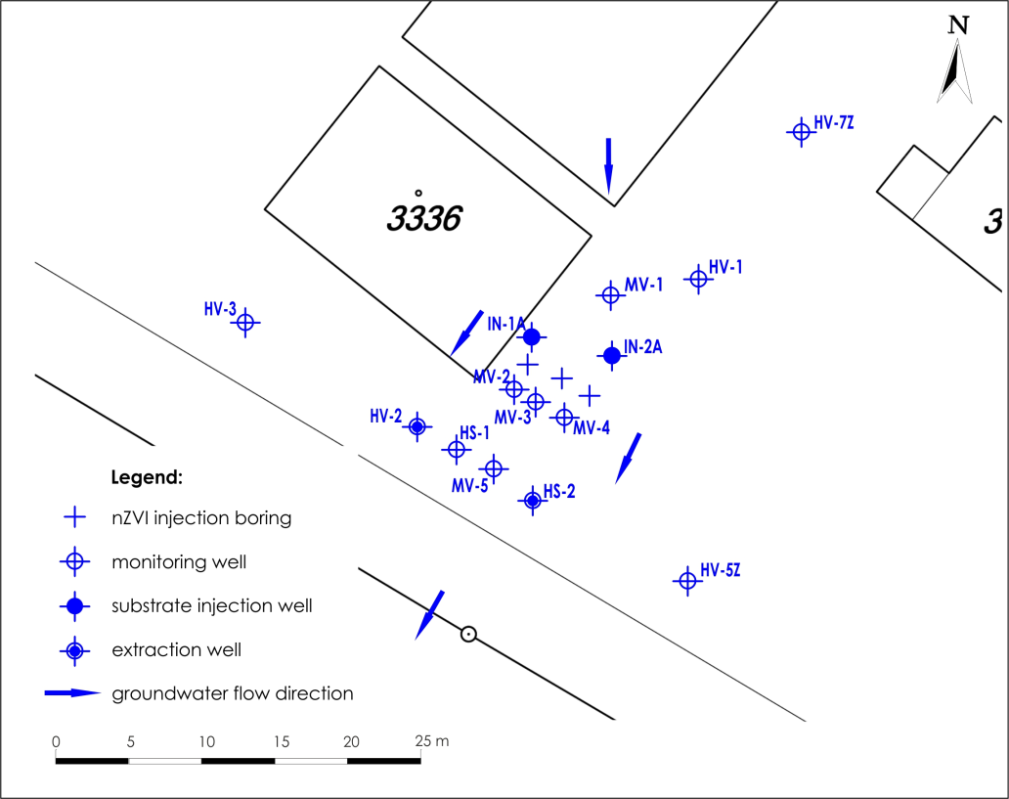
Combined Nano-Biotechnology for In-Situ Remediation of Mixed Contamination of Groundwater by Hexavalent Chromium and Chlorinated Solvents
Hydrogeological settings:
Quaternary aquifer (clayey gravel)
Saturated thickness 3.5 m
Cr(VI) concentration in groundwater
up to 50 mg/l
cVOCs concentration in groundwater
up to 6500 µg/l (TCE dominates)
TDS 800 – 900 g/l
Eh 300 - 440 mV
pH 7 – 7.2

Slide 11
Combined Nano-Biotechnology for In-Situ Remediation of Mixed Contamination of Groundwater by Hexavalent Chromium and Chlorinated Solvents
Cr(VI)

Slide 12
Combined Nano-Biotechnology for In-Situ Remediation of Mixed Contamination of Groundwater by Hexavalent Chromium and Chlorinated Solvents
CVOCs

Slide 13
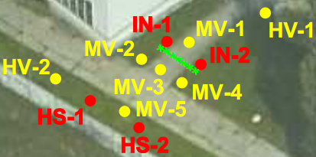
Combined Nano-Biotechnology for In-Situ Remediation of Mixed Contamination of Groundwater by Hexavalent Chromium and Chlorinated Solvents
Cr(VI) chlorine number

Slide 14
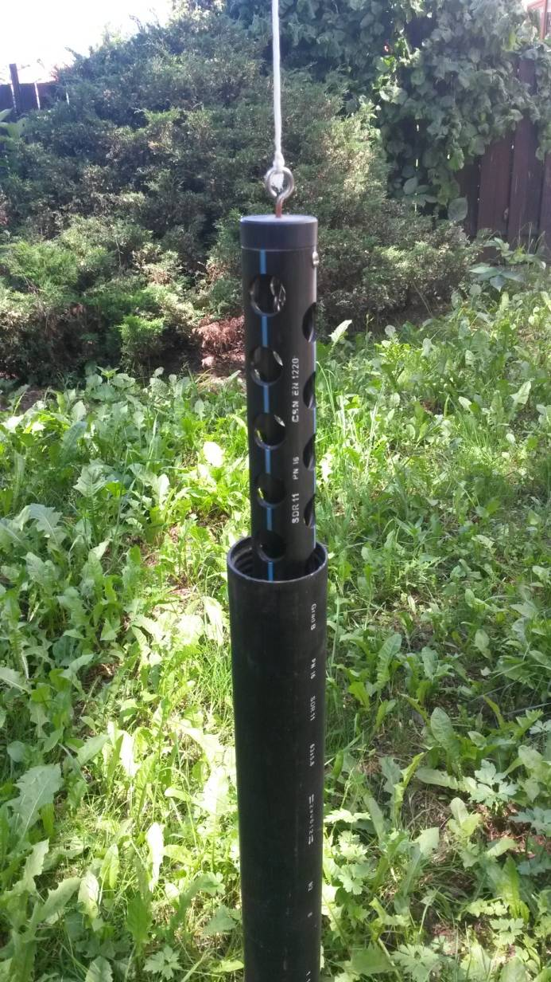
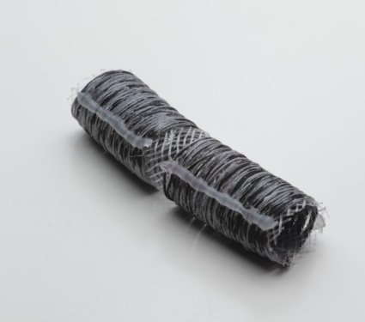
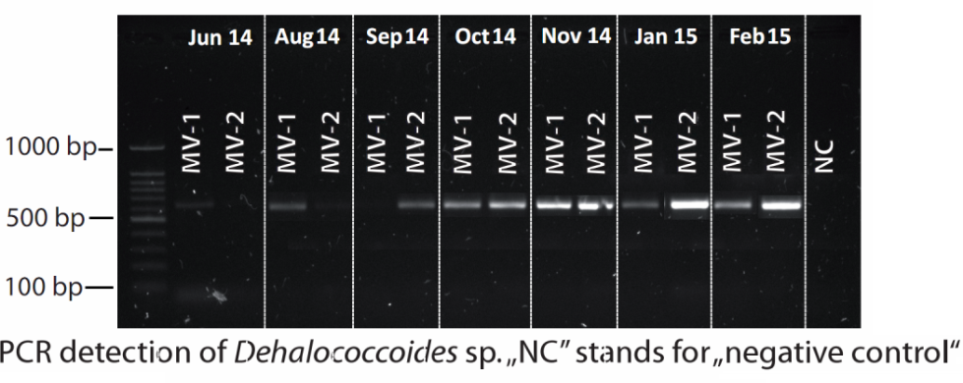
Combined Nano-Biotechnology for In-Situ Remediation of Mixed Contamination of Groundwater by Hexavalent Chromium and Chlorinated Solvents
Molecular biology methods
Detection of Dehalobacter , Dehalococcoides and Sulfurospirillium by PCR or qPCR
Presence of funcional genes (bvcA and vcrA) by qPCR
Total biomass quantified by qPCR using 16SrRNA and PLFA
Illumina MiSeq amplicon sequencing
Monitoring well
Nanofiber carriers

Slide 15
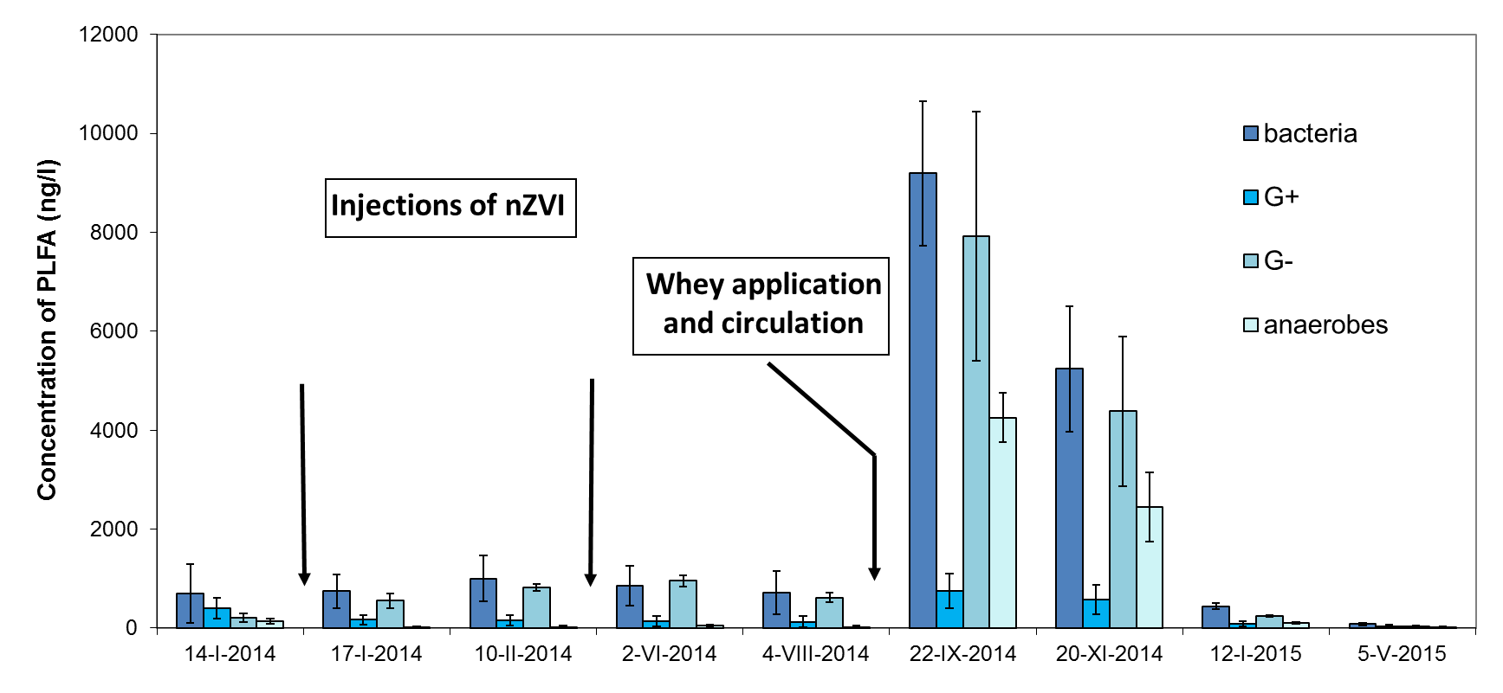
Molecular biology methods Transformation product analysis

Slide 16
Combination of nano-bio reduction exhibited high efficiency of Cr(VI) and cVOC removal
The results indicates a reciprocal effect of both the abiotic and the biotic processes: reduction of Cr(VI) by reductants (mainly Fe^{II}) produced or recycled by microbial processes
cVOCs were removed by chlororespiring community developed subsequently
Němeček J., Pokorný P., Lhotský O., Knytl V., Najmanová P., Steinová P., Černík M., Filipová A., Cajthaml T. Science of the Total Environment, doi:10.1016/j.scitotenv.2016.01.019.

Slide 17
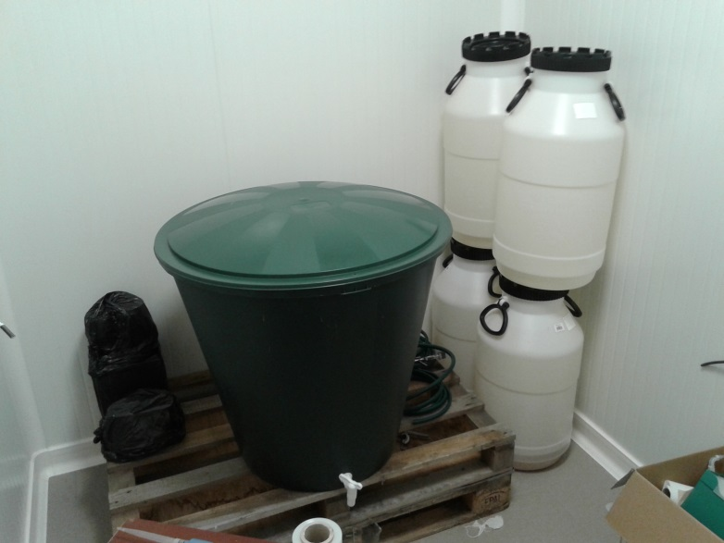
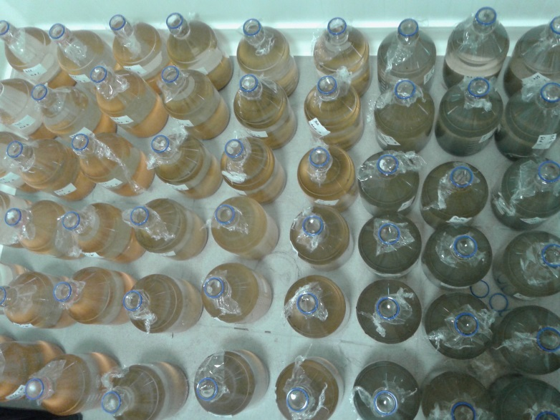
The effect of nZVI on resident microbial population from a real contaminated site
200 L of real contaminated water from Spolchemie company (Czech Republic)
Main contamination by chlorinated solvents
2 months of exposition with Biochar and a composite Biochar-nZVI material (0.7 g/L)
After 1 week, the addition of whey (170 mg/L)
Closed system, 14 ± 2 °C

Slide 18
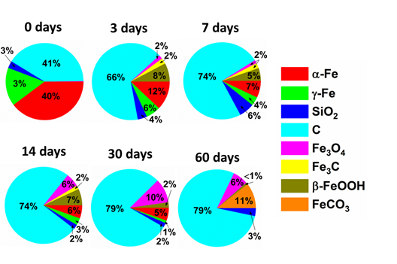
Evolution of nZVI-based material during the aging

Slide 19
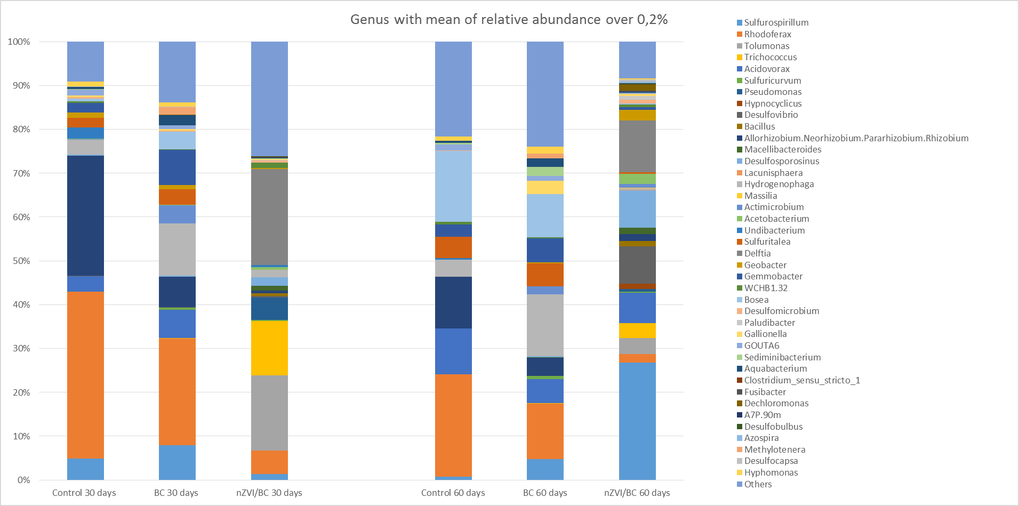
The effect on microbial communities of the contaminated site
1) qPCR
2) NGS

Slide 20
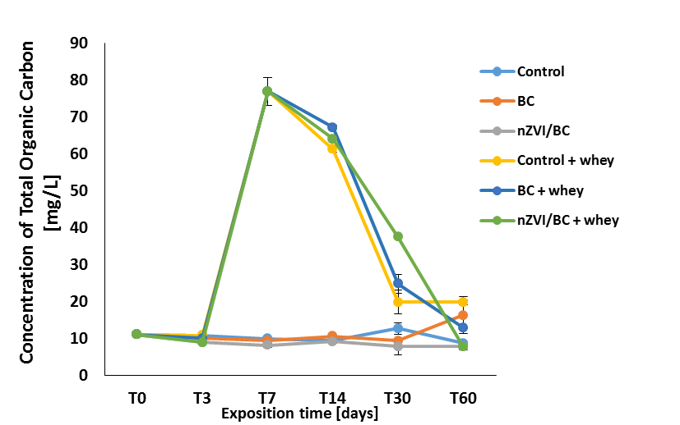
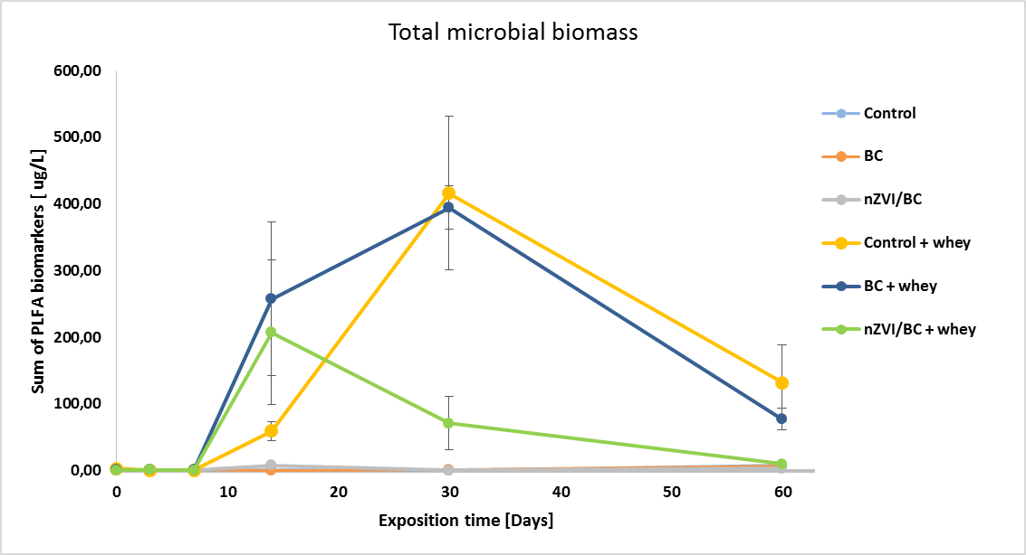
The effect on microbial communities of the contaminated site
- with the incorporation of a biostimulation step
Whey application
1) Total organic carbon
2) Microbial biomass estimated by phospholipid fatty acid analysis
Whey application

Slide 21
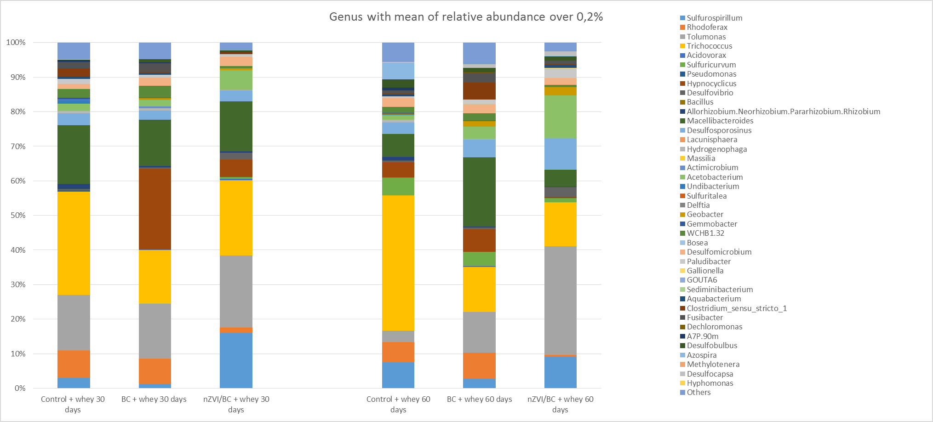
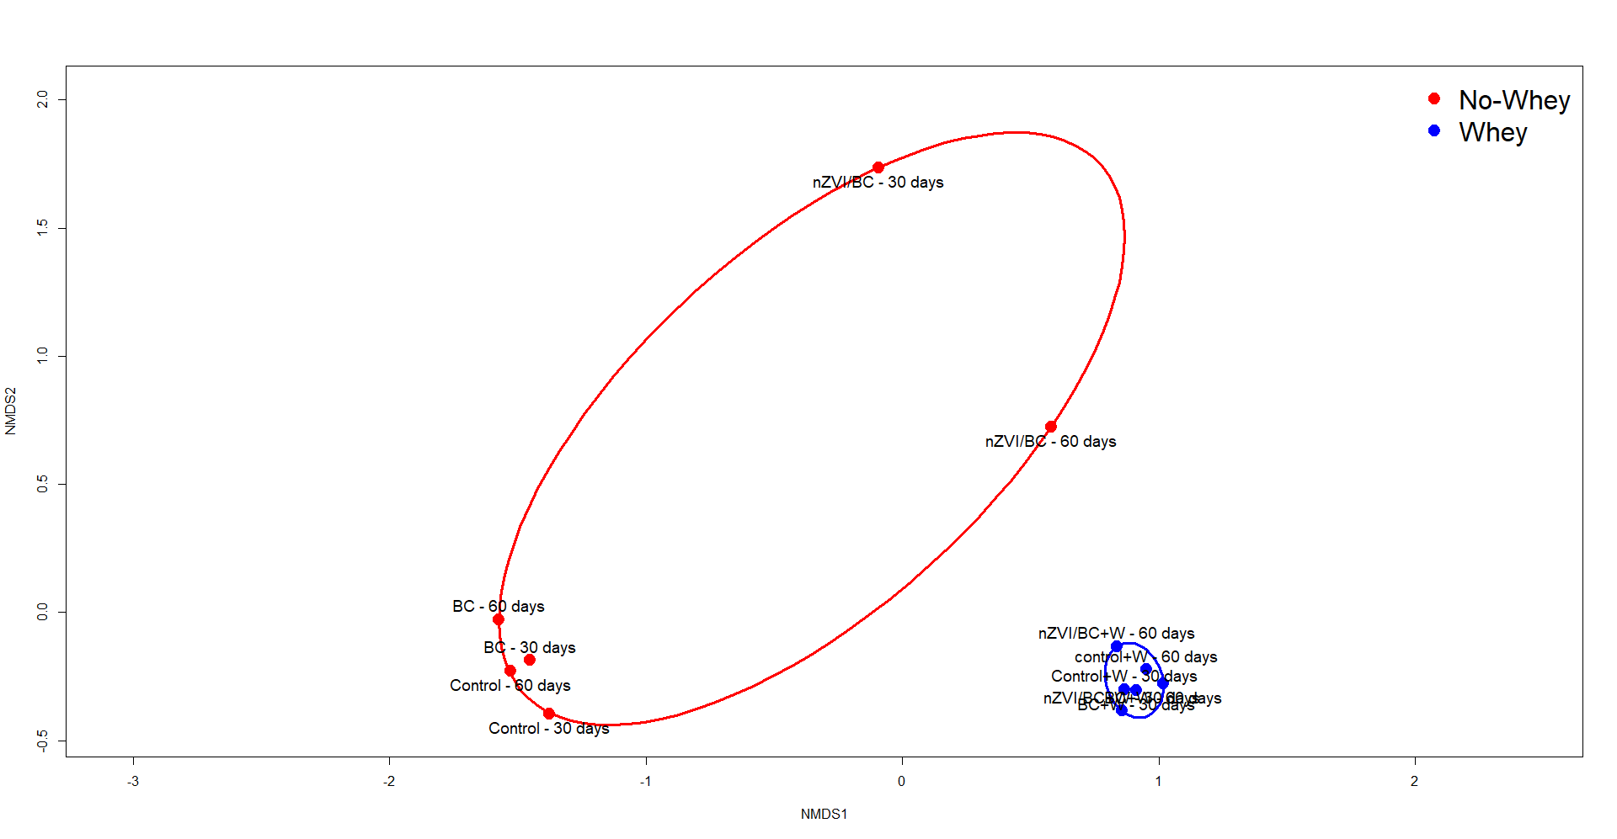
The effect on microbial communities of the contaminated site
- with the incorporation of a biostimulation step
3) qPCR
4) NGS

Slide 22
Risk assesment questions
Toxicity of nanoparticles - how to measure toxicity of nZVI?
The evolution of toxicity?
Are the oxidation products of nZVI more or less toxic?

Slide 23
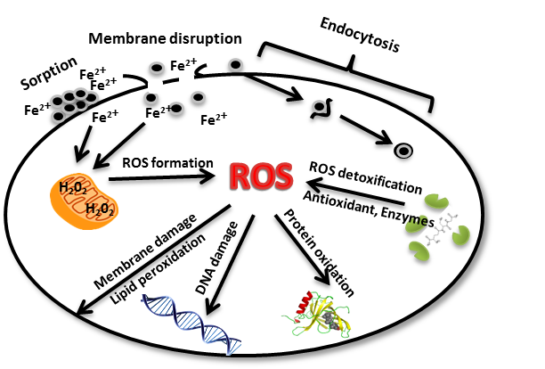
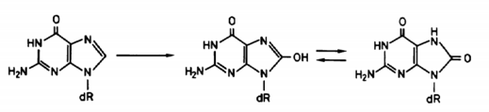
Oxidative damage of biomolecules caused by ROS
Cell-nanoparticle interactions
Fe⁰
1.
Fe⁰ + O₂ + 2 H⁺ → Fe²⁺ + H₂O₂
Fe⁰ + H₂O₂ → Fe²⁺ + 2 OH⁻
Fe²⁺ + H₂O₂ → Fe³⁺ + OH• + OH⁻
Fe³⁺ + H₂O₂ → Fe²⁺ + OOH⁻ + H⁺ → Fe²⁺ + 2 H⁺ + 2 O²⁻
2.
Formaldehyde
3.
Malondialdehyde
Benzaldehyde
Glyoxale
Formaldehyde
Methylglyoxale
Oxidized bases
Methacroleine
8-hydroxy-2'-deoxyguanosine
Acroleine
Methionale
Semerád, J, & Cajthaml, T 2016, 'Ecotoxicity and environmental safety related to nano-scale zerovalent iron remediation applications', Applied Microbiology And Biotechnology. ISSN: 1432-0614

Slide 24
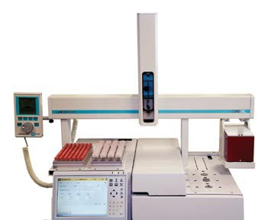
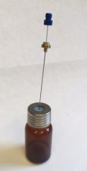
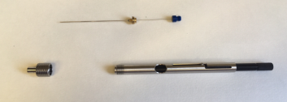
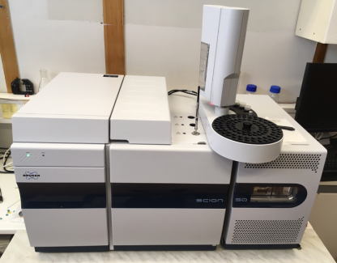
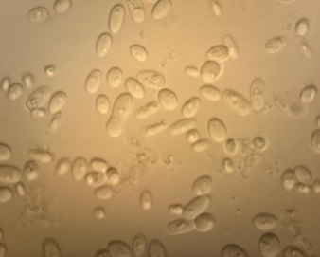
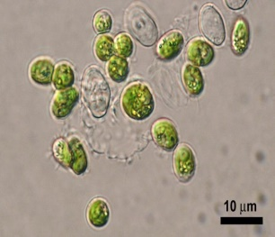
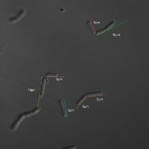
Markers of protein and lipid oxidation
Screening for new markers of oxidative stres damage was done using HS-SPME-GC-MS.
Two markers of protein oxidative damage were found in yeast and bacteria species.
Several other markers of lipid peroxidation were found in all microorganisms tested.
Aldehyde quantification could serve as a way of evaluating oxidative stress in environmental samples from sites of nZVI injection.
Fungi
Algae
Bacteria
Saccharomyces cerevisiae BY 4742
Desmodesmus subspicatus CCALA 688
Bacillus cereus DB 3035
Serratia marcescens CCM 303
Semerád et al. 2019 ‘Oxidative stress in microbes after exposure to iron nanoparticles: Analysis of aldehydes as oxidative damage products of lipids and proteins‘. Environmental Science and Pollution Research. In press.

Slide 25
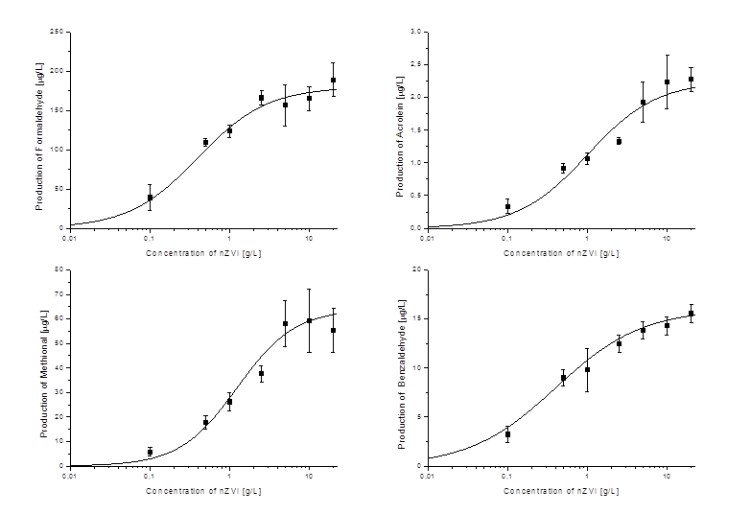
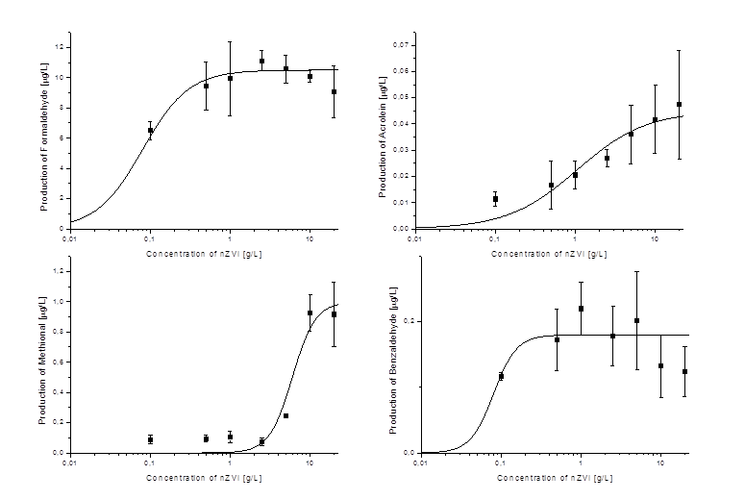
Markers of protein and lipid oxidation
Bacteria
Fungi
Serratia marcescens CCM 303
Bacillus cereus DB 3035
Saccharomyces cerevisiae BY 4742
Lipid peroxidation products
Products of protein oxidation
Glyoxale
Acrolein
Benzaldehyde
Formaldehyde
Methylglyoxale
Methacrolein
Methionale
Semerád et al. 2019 ‘Oxidative stress in microbes after exposure to iron nanoparticles: Analysis of aldehydes as oxidative damage products of lipids and proteins‘. Environmental Science and Pollution Research. In press.

Slide 26
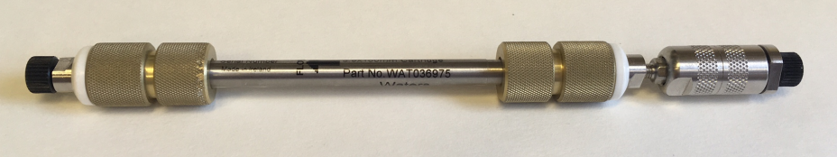
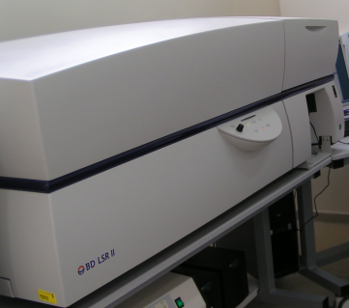
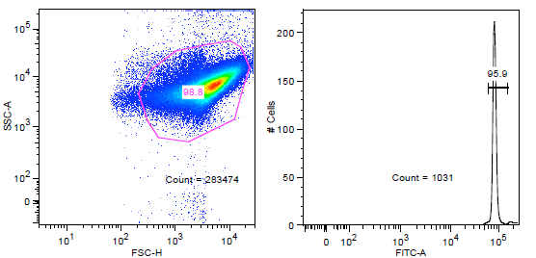
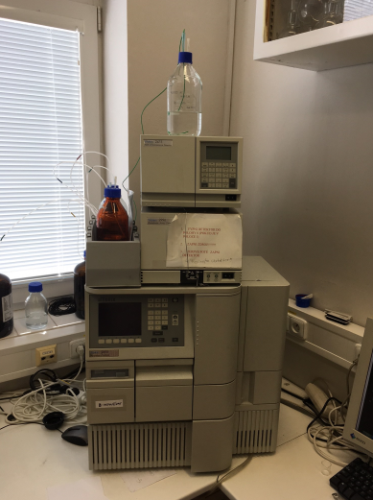
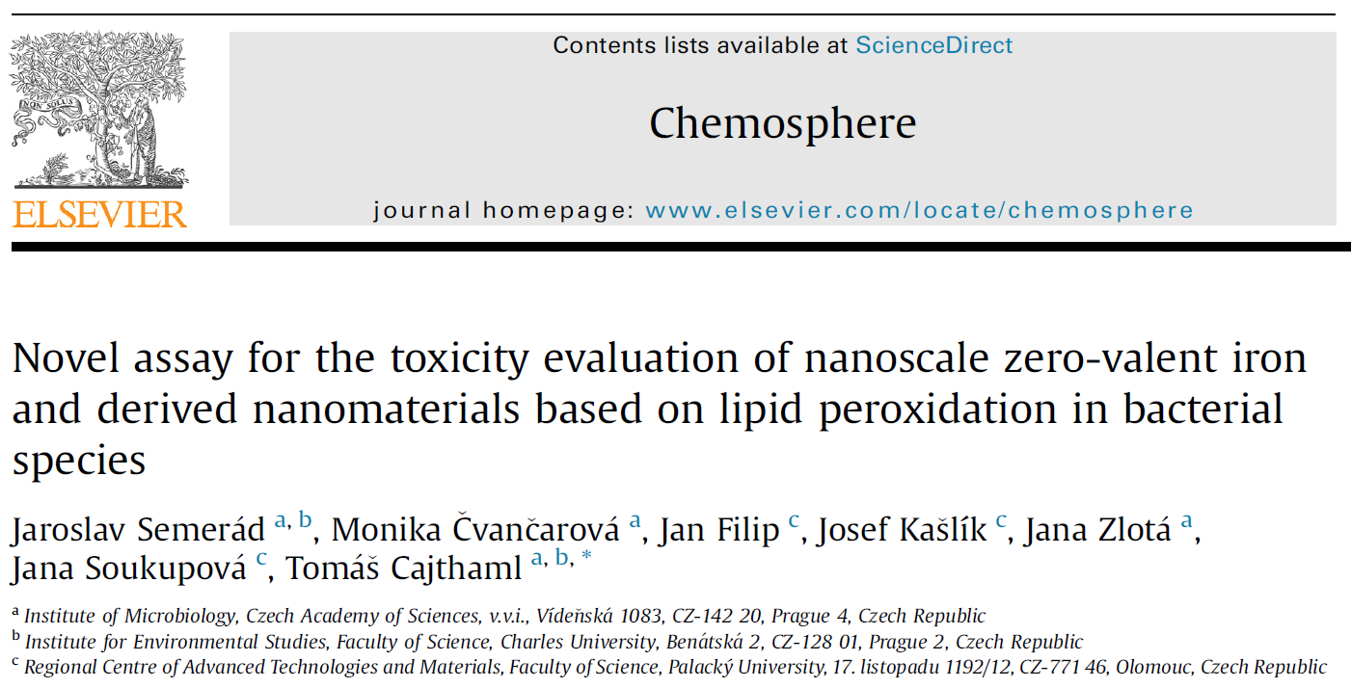
Quantification of malondialdehyde – a novel approach for toxicity testing of nZVI-based nanomaterials
1) Cultivation of tested bacteria
2) Preconcentration of bacterial suspension
3) Cell counting by flow cytometry
4) Exposition with iron nanoparticles
5) Reaction with thiobarbituric acid
6) Extraction of MDA-TBA complex
7) Quantification by RP-HPLC-FLD method

Slide 27
Application of MDA assay to determine acute toxicity of newly developed nZVI-based nanoparticles
Pseudomonas putida CCM
 | EC₅₀ [g/L] | EC_{50corrected} [g/L]
nZVI | 0.5 | 0.5
S-nZVI 0,25% | 0.5 | 0.6
S-nZVI 1% | 0.4 | 1.0
S-nZVI 5% | 0.4 | 5.7
Semerád et al. 2019, Environmental fate of sulfidated nZVI particles: interplay of nanoparticle corrosion and toxicity during the aging

Slide 28


Aging of nanoparticles during 60 days
Fe⁰
Fe⁰
FeO_{x}
Fe⁰
Day 0
Day 60

Slide 29
Aging of nanoparticles during 60 days
Fe⁰
Fe⁰
FeO_{x}
Fe⁰

Slide 30

Conclusions
nZVI cause oxidation to biomolecules in microbes
Toxicity of nZVI rapidely decrease during the time
nZVI decrease level of contamination and overall toxicity
Recent results proves a reciprocal effect of both the abiotic and the biotic processes: reduction of contaminants by reductants (mainly Fe^{II+}) produced or recycled by microbial processes

Slide 31
Thank you for your attention

